Slide 1
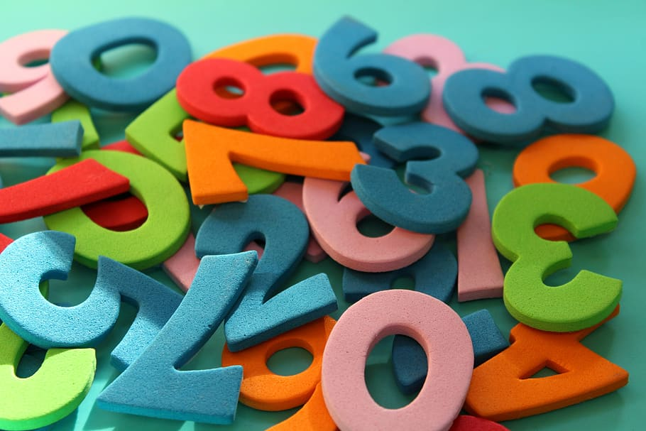
Multiplication
Workshop
Print
Notes:
Intro

Slide 2
Why does the Multiplication Timetable Check (MTC) take place in Year 4?
The check is designed to identify pupils who are not yet able to fluently recall their multiplication facts, so that additional support can be provided.
Became a statutory requirement from the 2024/25 academic year.
Results are reported to schools as a total score out of 25 for all pupils that took the check.
There is no expected standard in the multiplication tables check, but higher scores indicate greater proficiency in fluently recalling multiplication tables.
Notes:
Explain this is only the second year it has taken place as delayed due to COVID

Slide 3
How it works
Delivered as an online assessment within a 3-week window in June 2025.
25 questions worth one mark each.
Pupils have 6 seconds to enter a response to the question. This is based on research which deemed 6 seconds enough time to allow pupils to recall and input their responses. There is then a 3 second pause between each question.
Whole assessment takes less than 5 minutes to complete.
Questions are selected from the 121 items that make up the 2 to 12 multiplication tables.
Emphasis on the 6, 7, 8, 9 and 12 multiplication tables.
It does not include division facts.
Notes:
TTRS grid shows that anything in green is already being answered within 3-4 seconds. Red means 10+ seconds.

Slide 4
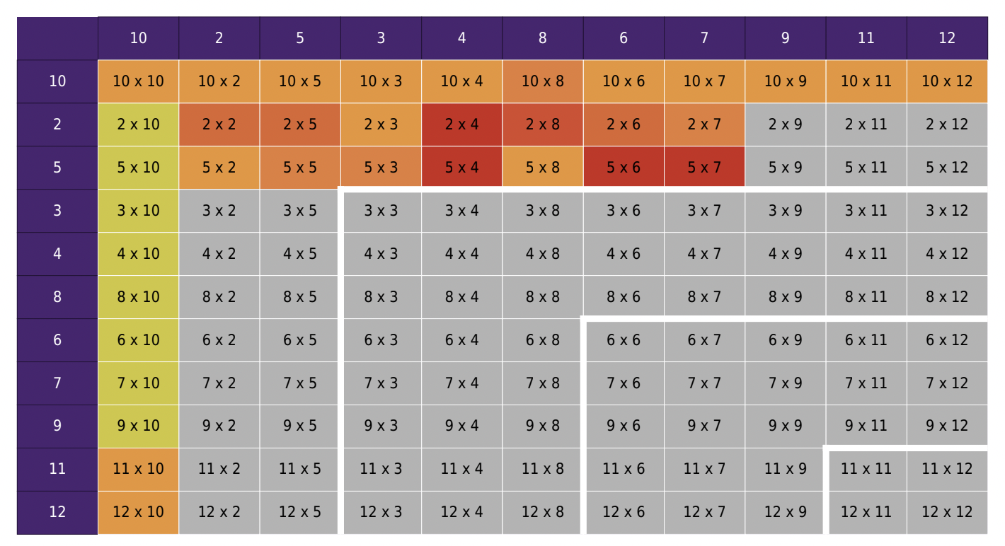
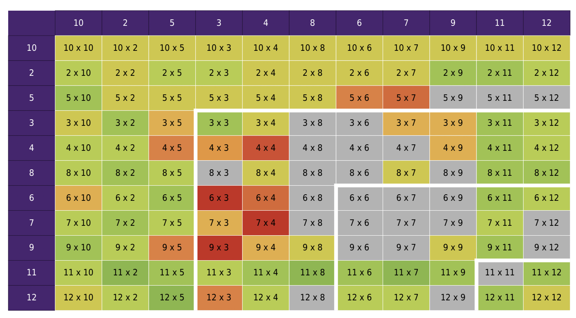
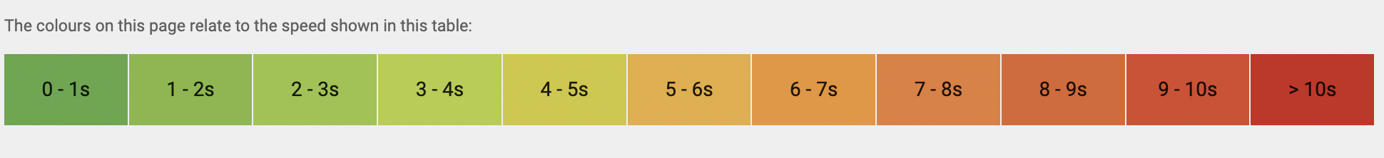
Times Tables Rock Stars Heat Maps

Slide 5
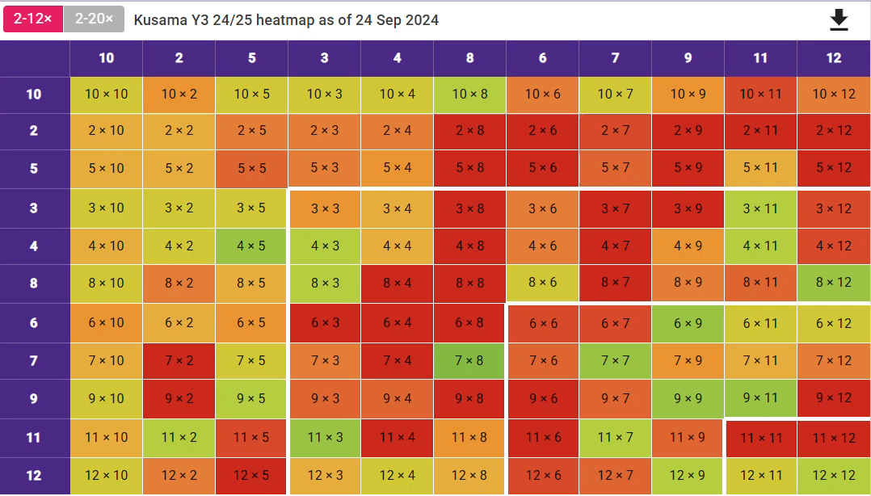
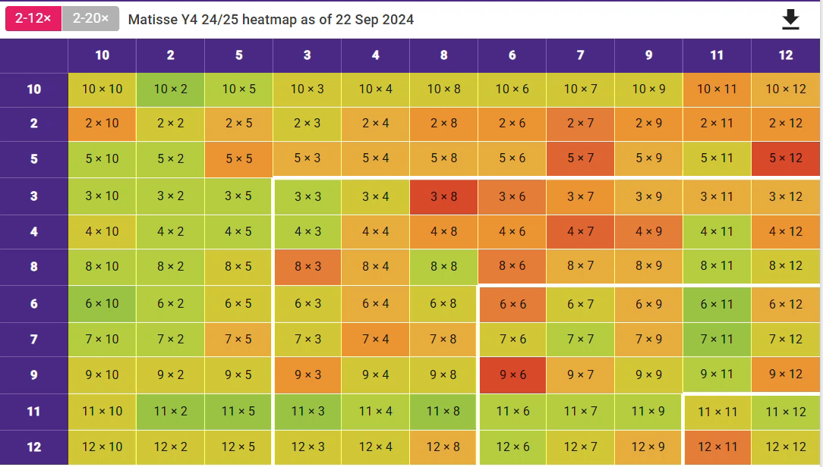
Our Heatmaps from Sep 24 to now.
By getting our heatmaps as green as possible in Year 3, we can refine and finesse our times tables in Year 4.
Multiplication tables help us in all areas of maths so it's important to get them learnt as early as possible!

Slide 6
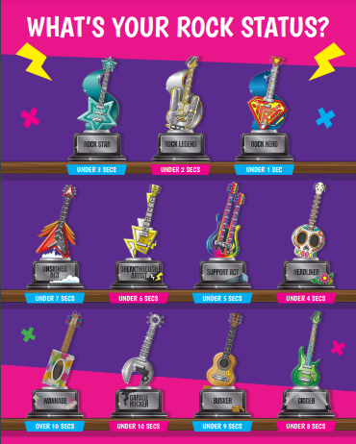
Success Criteria:
To reach a minimum Rock Star status of either:
Breakthrough Artist = Under 6 seconds
or
Support Act =
Under 5 seconds

Slide 7
How we teach multiplication tables
Fast Maths - children should be able to use a multiplication grid first to build accuracy skills before fluency and speed.
Games - multiplication pairs, multiplication bowling, Hit the Button (Top Marks)
Memory recall activities - 7x grid, 9x easy method, doubling 4x for 8x and 3x for 6x, adding 10x + 2x for 12x (stand up, heads, shoulders etc)
Songs
White Rose Maths multiplication blocks of learning

Slide 8
Activities you will see today
Fast Maths
Times tables loop card game
Written multiplication e.g. 456 x 5 =
Multiplication brain break - watchkin.com/b7969628d9

Slide 9
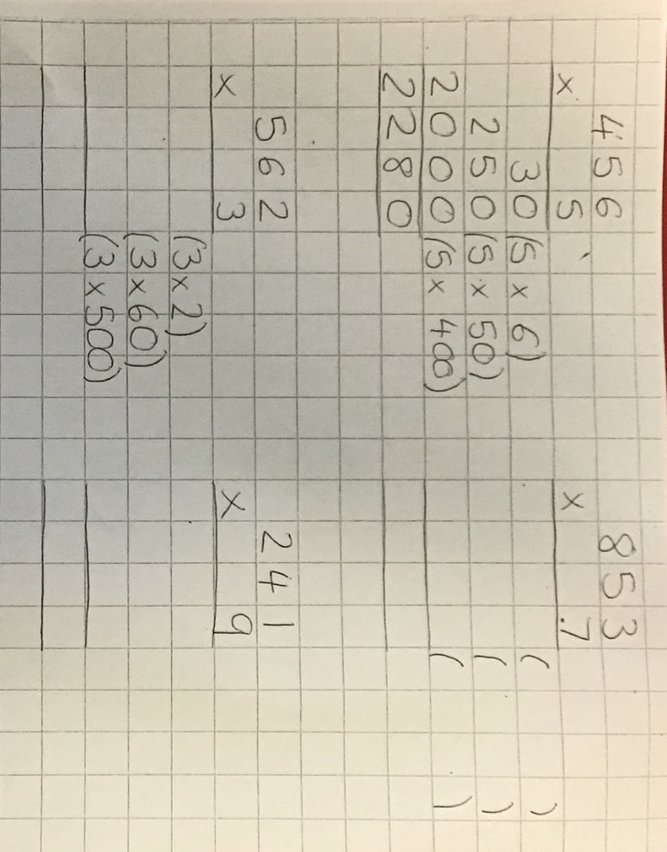
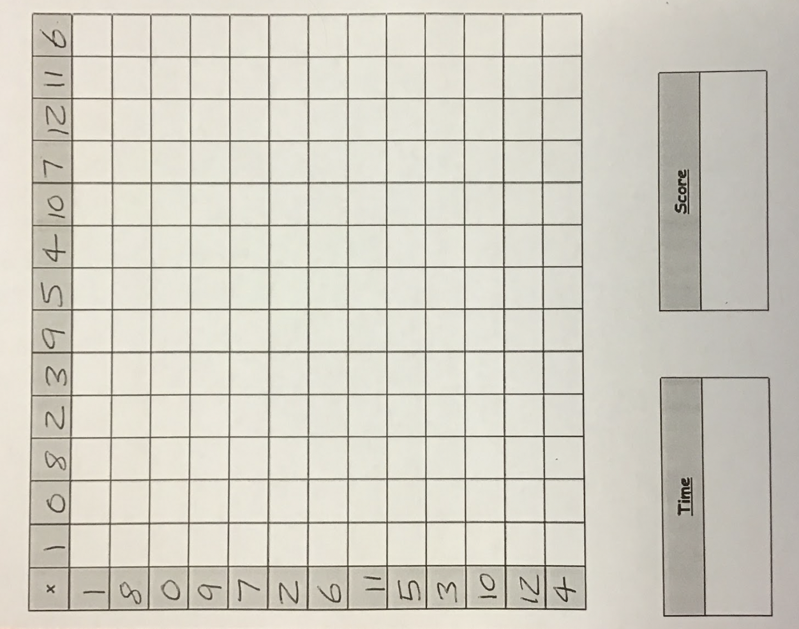
Fast maths grid.
10 minutes to complete the whole grid. We do this every Friday in class.
First step method for multiplying 2-digit and 3-digit by 1-digit numbers

Slide 10


Fast maths

Slide 11
Around the room there are cards with a question and an answer.
Answer the question and then find the card with the correct answer.
Keep going until you are back to where you started (It doesn't matter where you start!)
Write down all your calculations.
Loop card game

Slide 12
Activities you will see today
Fast Maths
Times tables loop card game
Written multiplication e.g. 456 x 5 =
Multiplication brain break - watchkin.com/b7969628d9

