Slide 1
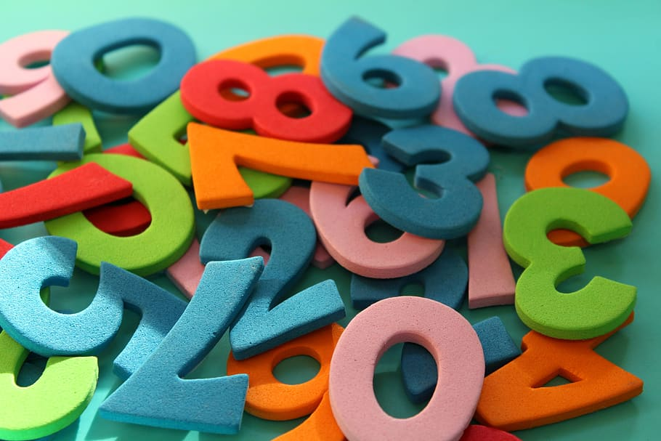
Multiplication Tables Check
(MTC) Workshop 2026
Print
Notes:
Intro

Slide 2
Why does it take place?
The check is designed to help schools identify pupils who are not yet able to fluently recall their multiplication facts, so that additional support can be provided.
Became a statutory requirement from the 2021/22 academic year.
Results are reported to schools as a total score out of 25 for all pupils that took the check.
There is no expected standard in the multiplication tables check, but higher scores indicate greater proficiency in fluently recalling multiplication tables.
Notes:
Explain this is only the second year it has taken place as delayed due to COVID

Slide 3
How it works
Delivered as an online assessment within a 3-week window in June 2026.
25 questions worth one mark each.
Pupils have 6 seconds to enter a response to the question. This is based on research which deemed 6 seconds enough time to allow pupils to recall and input their responses. There is then a 3 second pause between each question.
Whole assessment takes less than 5 minutes to complete.
Questions are selected from the 121 items that make up the 2 to 12 multiplication tables.
Emphasis on the 6, 7, 8, 9 and 12 multiplication tables.
It does not include division facts.
Notes:
TTRS grid shows that anything in green is already being answered within 3-4 seconds. Red means 10+ seconds.

Slide 4
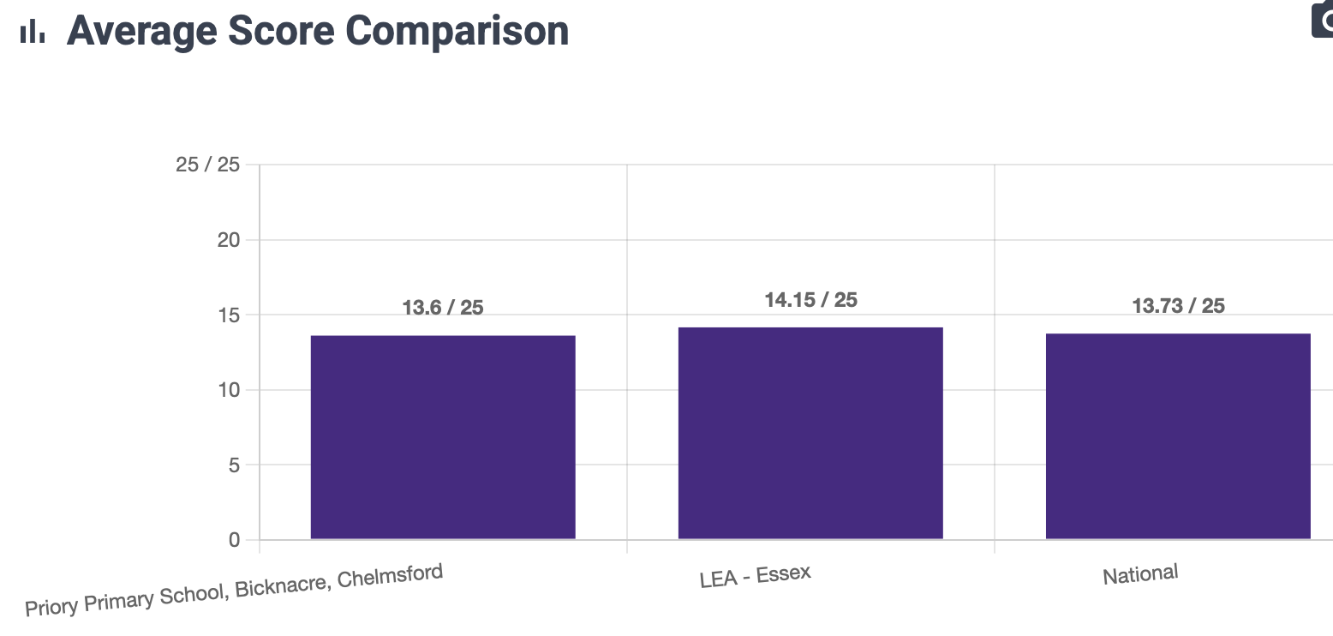
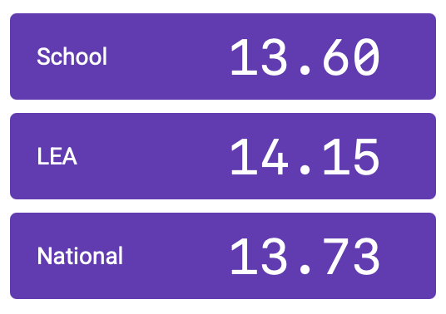
Y4 Unofficial Autumn MTC Data

Slide 5
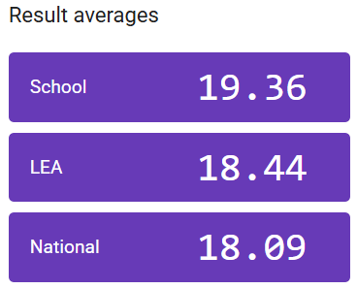
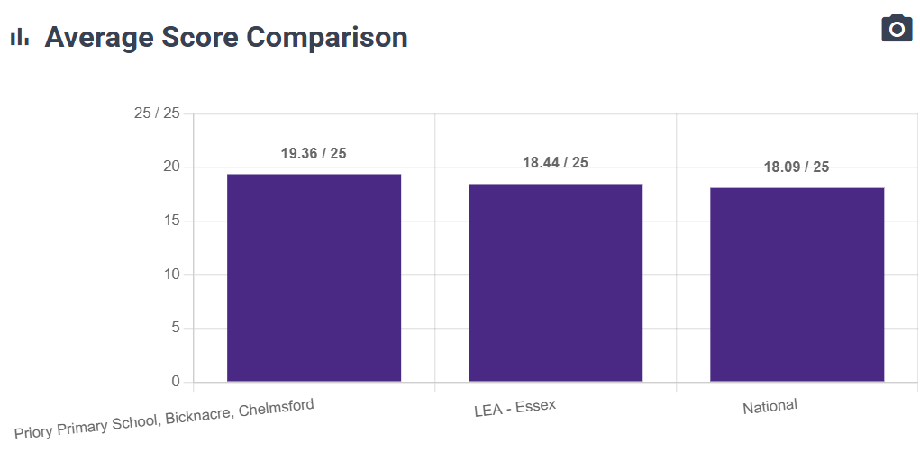
Y4 Unofficial Spring MTC Data

Slide 6
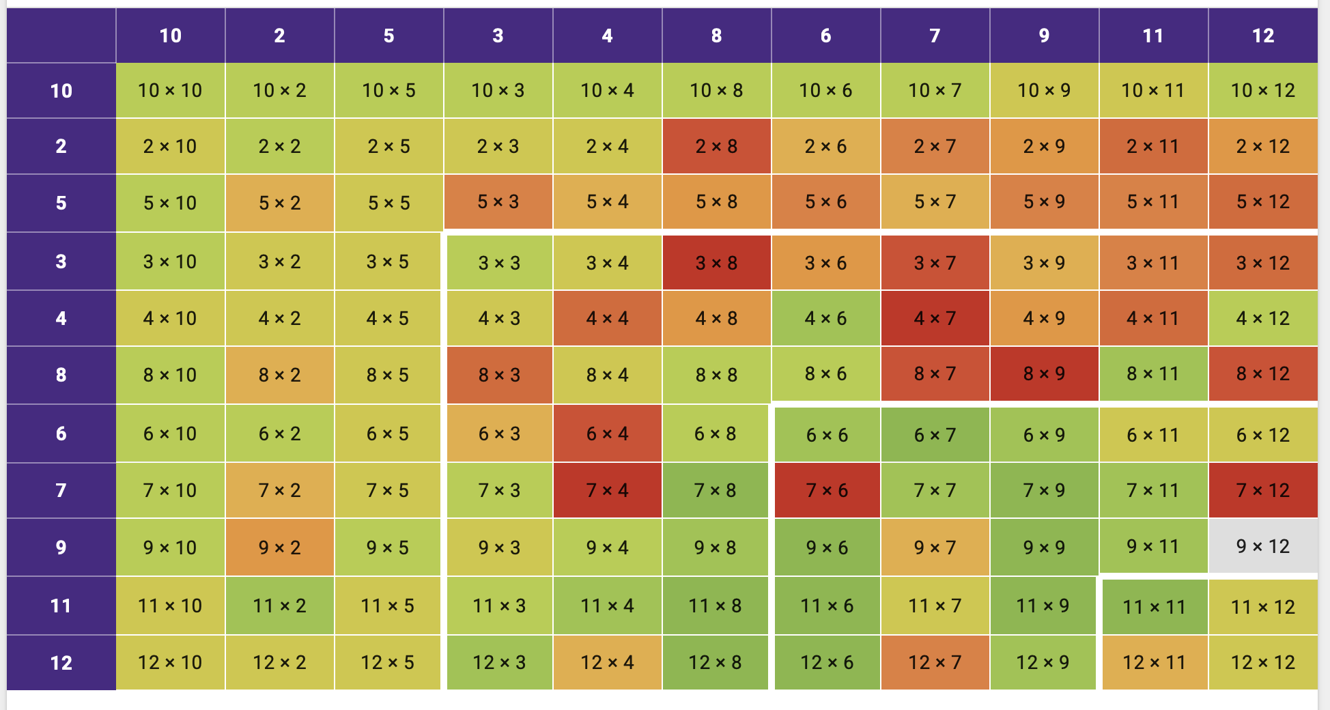
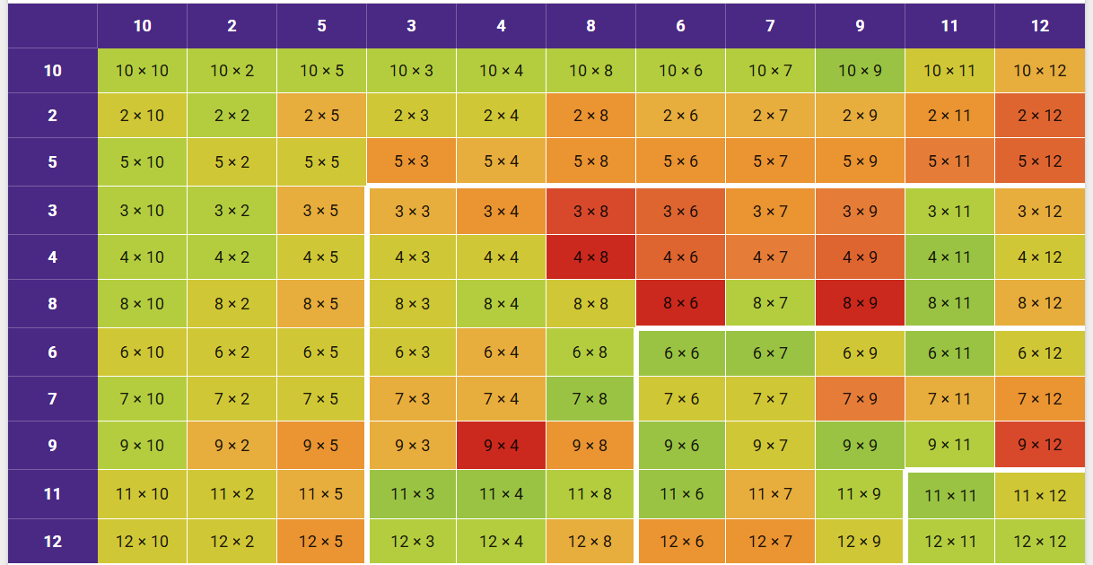
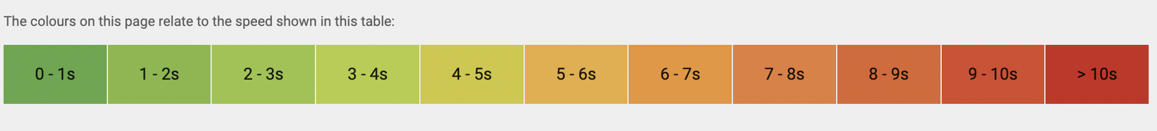
Kusama (Y3) Times Tables Rock Stars Heat Maps
Autumn 2025 Spring 2026

Slide 7
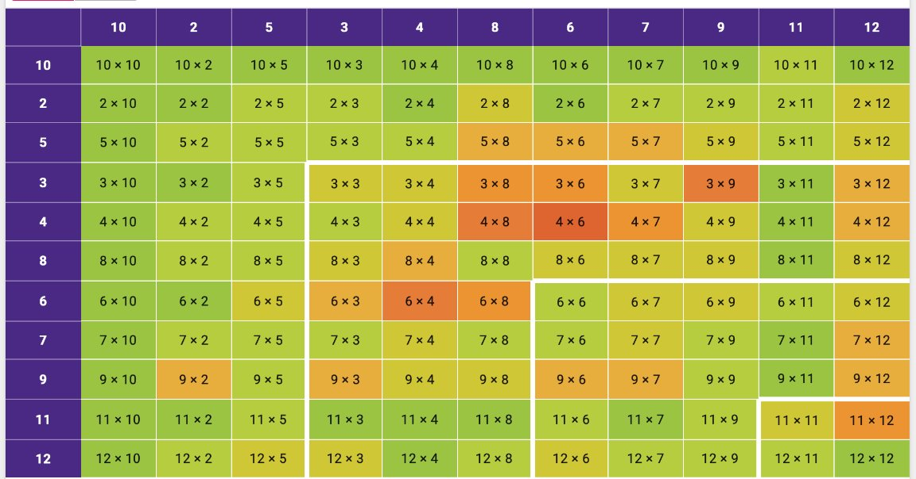
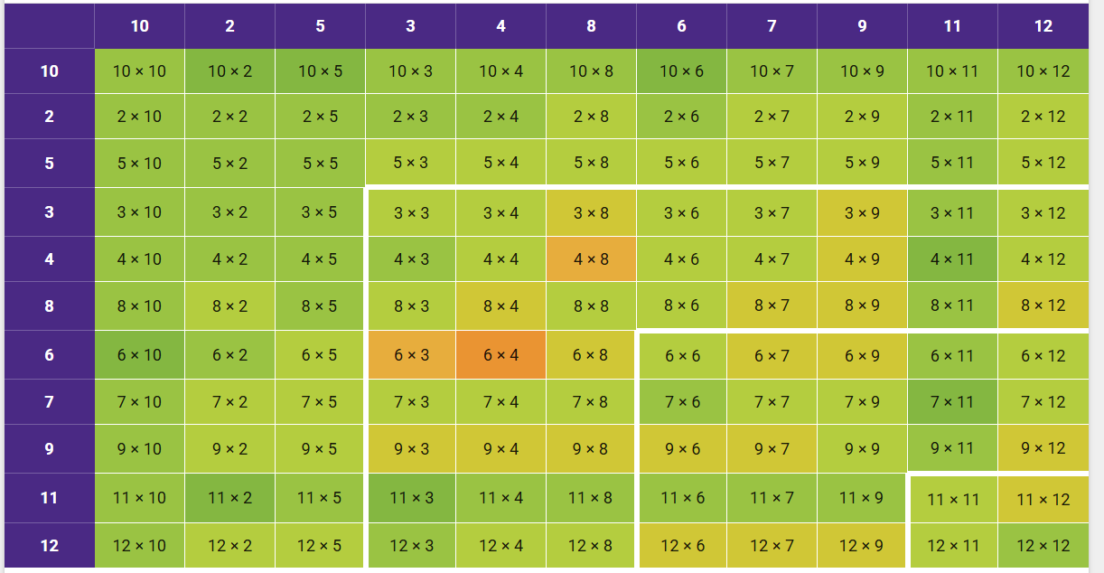
Matisse (Y4) Times Tables Rock Stars Heat Maps
Autumn 2025 Spring 2026

Slide 8
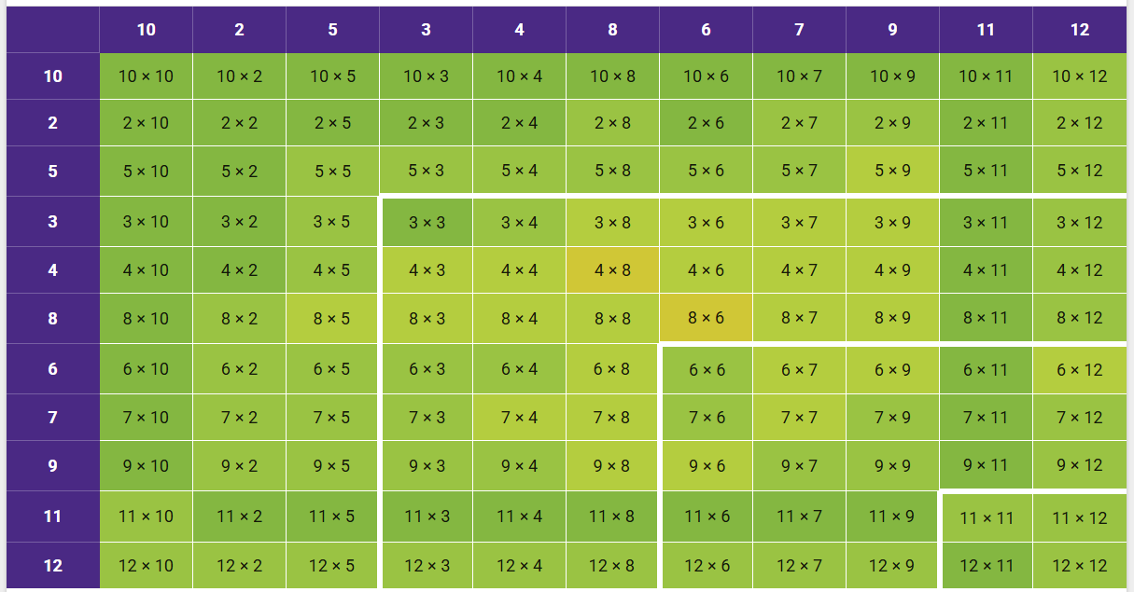
Warhol (Year 6) Spring 2026 Heat Map

Slide 9
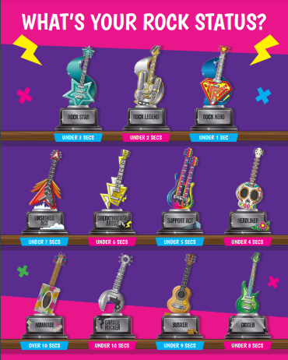
Success Criteria:
To reach a minimum Rock Star status of either:
Support Act = Under 5 seconds
or
Headliner = Under 4 seconds

Slide 10
How we teach multiplication tables
Fast Maths - children use a multiplication grid first to build accuracy skills before fluency and speed.
NCETM – Maths Number Mastery, multiplication focus 15 minutes per day.
Songs and games – multiplication pairs, multiplication bowling, loop games, body counting.
White Rose Maths multiplication blocks of learning.

Slide 11
Activities you will see today
Times tables loop game
NCETM – example of a method taught to learn 9x tables
Fast Maths
Written multiplication 3-digit by 1-digit e.g. 456 x 5 =
Multiplication brain break - 12 Times Table Song (cover of Treat You Better by Shawn Mendes)

Slide 12
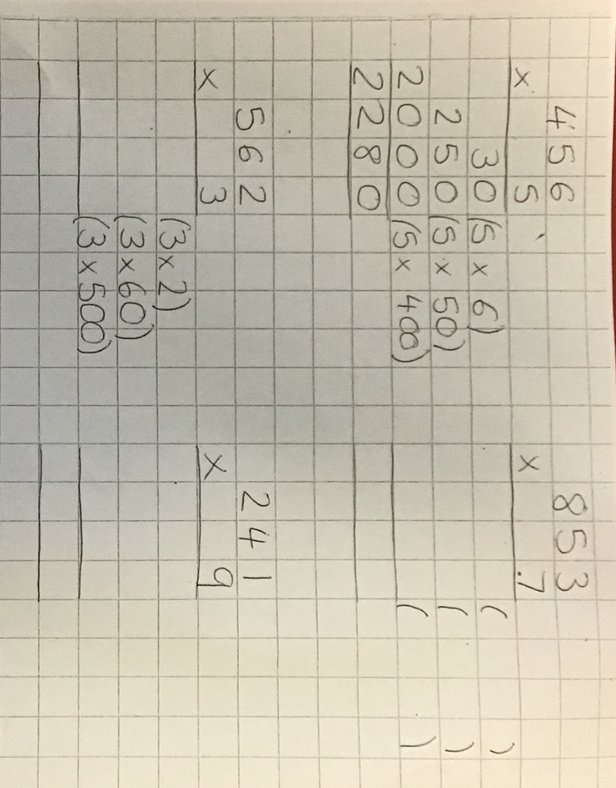
First step methods for multiplying 3-digit by 1-digit numbers

Slide 13
Activity 1
Times tables loop game
Using a whiteboard and pen and your chosen method, work out the multiplication question shown on the paper.
The answer will be shown on another piece of paper.
Once found, you then calculate the next question and go to find that answer.
If you cannot find the answer anywhere, you need to check your calculation!

Slide 14

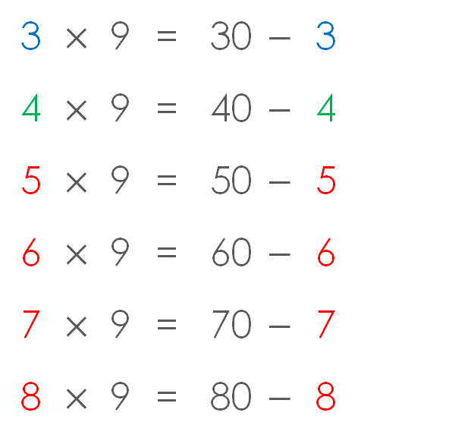


I know that 10 fours are 40. To calculate 9 fours I need to subtract four from 40.
Can you complete the rest of these balanced equations?
Activity 2 - NCETM Maths Mastery Meeting
I know that 10 threes are 30. To calculate 9 threes I need to subtract three from 30.
3 | $$×$$ | 9 | = | 30 | $$−$$ | 3
4 | $$×$$ | 9 | = | 40 | $$−$$ | 4
5 | $$×$$ | 9 | = | 50 | $$−$$ | 5
6 | $$×$$ | 9 | = | 60 | $$−$$ | 6
7 | $$×$$ | 9 | = | 70 | $$−$$ | 7
8 | $$×$$ | 9 | = | 80 | $$−$$ | 8
$×$9
$×$10
9 _____s is equal to 10 _____s subtract 1 _____ .

Slide 15
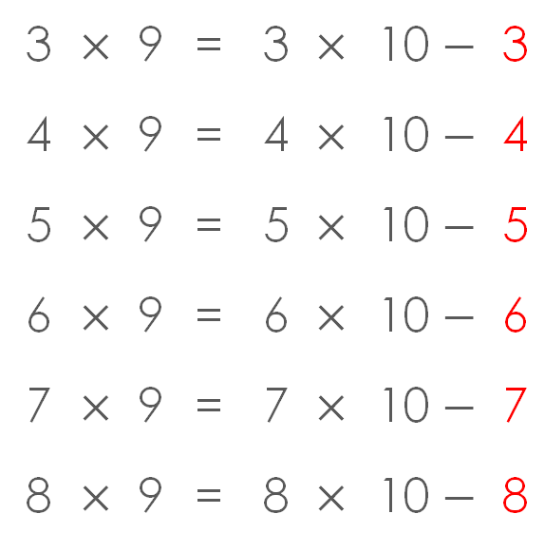
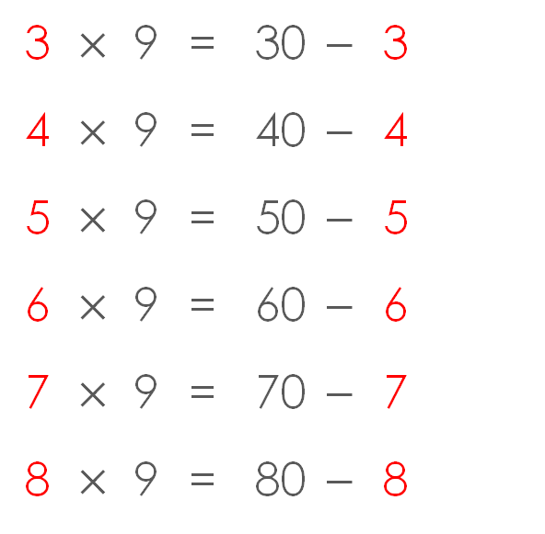
What’s different?
What’s the same?
3 | $$×$$ | 9 | = | 3 | $$×$$ | 10 | $$−$$ | 3
4 | $$×$$ | 9 | = | 4 | $$×$$ | 10 | $$−$$ | 4
5 | $$×$$ | 9 | = | 5 | $$×$$ | 10 | $$−$$ | 5
6 | $$×$$ | 9 | = | 6 | $$×$$ | 10 | $$−$$ | 6
7 | $$×$$ | 9 | = | 7 | $$×$$ | 10 | $$−$$ | 7
8 | $$×$$ | 9 | = | 8 | $$×$$ | 10 | $$−$$ | 8
3 | $$×$$ | 9 | = | 30 | $$−$$ | 3
4 | $$×$$ | 9 | = | 40 | $$−$$ | 4
5 | $$×$$ | 9 | = | 50 | $$−$$ | 5
6 | $$×$$ | 9 | = | 60 | $$−$$ | 6
7 | $$×$$ | 9 | = | 70 | $$−$$ | 7
8 | $$×$$ | 9 | = | 80 | $$−$$ | 8

Slide 16
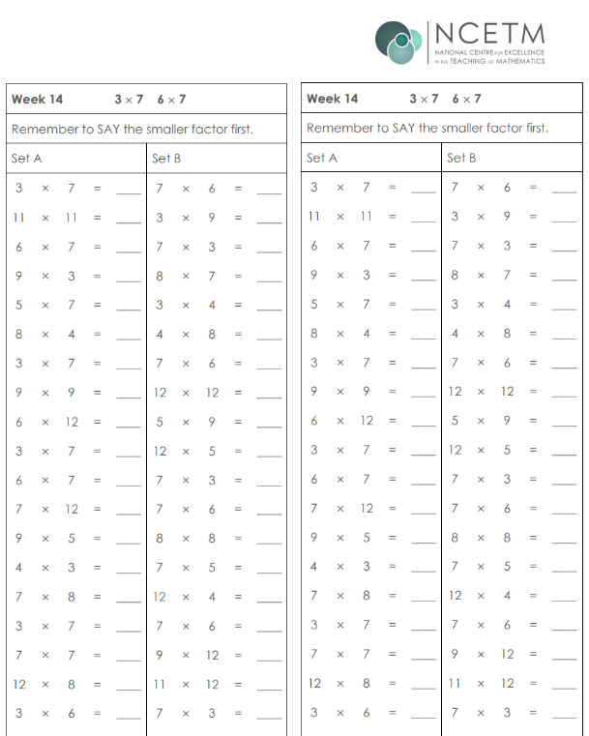
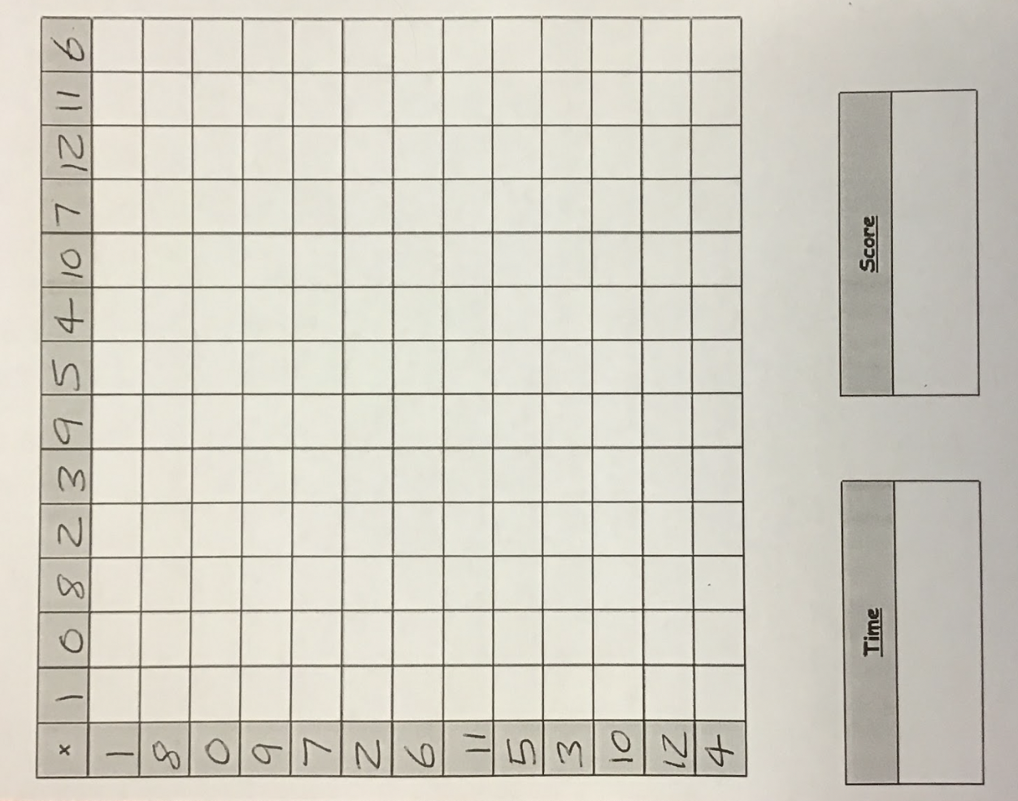
Activity 3 - Fast maths
Year 3 complete these grids each week with set times tables.
Year 4 complete these grids with all 12 multiplication tables.

Slide 17


Fast maths

Slide 18
Brain Breaks
Multiplication brain break – body counting
12 Times Table Song (cover of Treat You Better by Shawn Mendes)

