Slide 1
Welcome to
meet the teacher
Matisse Class - Year 3 / 4
2026 - 2027

Slide 2
A bit about me
I worked in the foreign trade standards industry, working in overseas offices to ensure exported goods from the U.K. meet relevant trading standards.
After starting my family, travel became more difficult so I made the decision to change careers and started working as a Learning Support Assistant, specialising in SEND and Maths in 2006.

Slide 3
Staff in class each week
Mrs Sullivan – Class Teacher
Ms Smyth – Higher Level Teaching Assistant (HLTA)
Mrs Cutts - Learning Support Assistant
Senorita Perez – Spanish Teacher - 1 hour on a Thursday
Mrs Chandler – HLTA – Teaching Wednesday afternoon

Slide 4
Daily Timings
Please be on time!
Start of the day
8:30 - The gates will open
Parents and carers must accompany and supervise their children in the playground, unless they are Y6 children and have parental consent to walk
to and from school unaccompanied.
8:40 - Bell will ring and children should make their way to the classroom door.
8:50 - The gates will be locked.
End of day
3.15 - Gate will be opened and children collected from the classroom door.

Slide 5
Every Day
Things to remember
Reading Record
Accelerated Reader Book
Water Bottle
Healthy Snack
Suitable coat for the weather
Pencil cases are not to be brought into school as all stationary is provided.
P.E. Days
Tuesday and Friday
Lunch
Packed lunch or
pre-ordered school dinner

Slide 6

Uniform expectations
All children
  Blue jumper/cardigan with embroidered logo
  Blue polo shirt with or without embroidered logo
  Grey school trousers/ tailored shorts/skirt or tunic - no leggings or jogging bottoms
  Grey or white socks / grey tights
  Blue checked summer dresses – can be worn after Easter until October half term
  Sun hat/cap or woolly hat when required
  For safety reasons NO large bags are allowed in school. Please ensure your child has a small bag for daily use that can easily fit in a small school locker.
  Coats – appropriate to weather e.g. winter / raincoats. Coats need to have a coat hook and be able to fit on coat pegs easily in a small space
  Black school shoes (open-toes, sling back shoes or high heels are NOT permitted).

Slide 7
P.E. Kit Expectations
All children
P.E. kit to be in school every Tuesday and Friday
  White or Blue Logo T-shirt
  Plain White T-Shirt
  Black Shorts
  Black jumper / tracksuit top
  Black jogging bottoms
  Plain sports trainers or black plimsoles

Slide 8
Presentation Expectations
All children
  Hair accessories should be plain and black, white, brown or blue in colour. Children will be asked to remove anything else.
  Shoulder-length hair and longer must be tied back.
  Simple watches that do no more than tell the time.
  Plain stud earrings can be worn only on the understanding that this is at the child's own risk.
  Pupils need to be able to remove their own earrings for P.E., small containers can be brought into school to put them into.
  No nail varnish or false nails
  No makeup – children will be asked to remove this in school.

Slide 9
All children
Home Learning
​
Reading - 15 minutes per day and recorded in their reading diaries​.
​
Maths or English – 20 mins Home learning tasks will be set on Atom Learning every Friday for completion by the following Thursday. ​Sometimes this maybe a practical task, which will be notified on Google Classroom
​Spellings - 20 mins a week - make this fun! There is only 6 each week and each half term spellings will be available on Google Classroom.
Spelling quiz will be on Wednesday afternoon and will be marked by class teacher.​
​Times tables – Government Multiplication Tables Check (MTC) for Year 4's takes place in June. Children are expected to have secured a rapid recall of ​all times tables facts up to the 12 times table. ​There will be 25 random questions to answer within 6 seconds each. All children should practise on TTRS regularly to build fluency.

Slide 10
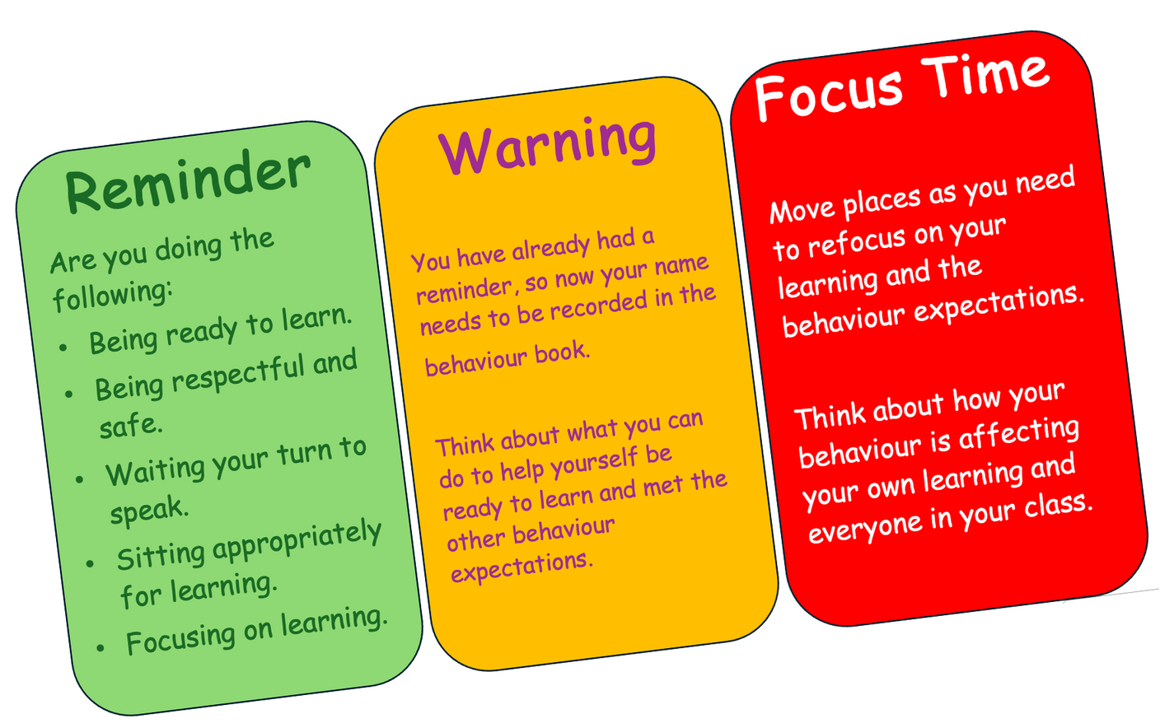
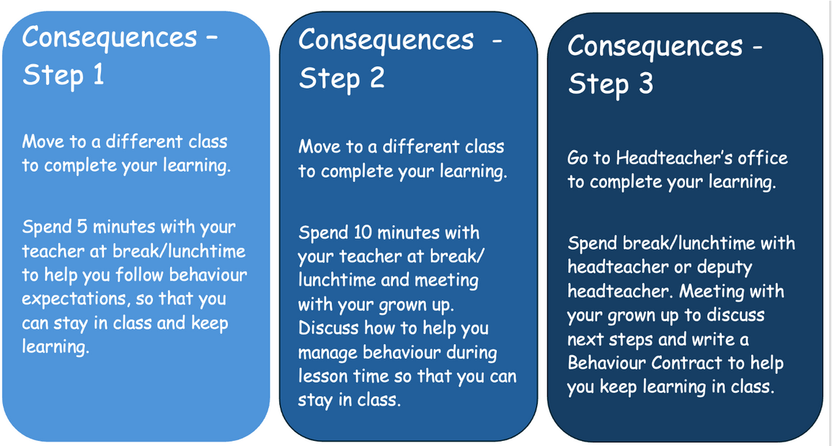
Behaviour
Expectations
Ready Respectful Safe
School procedures in place to help the children regulate themselves

Slide 11

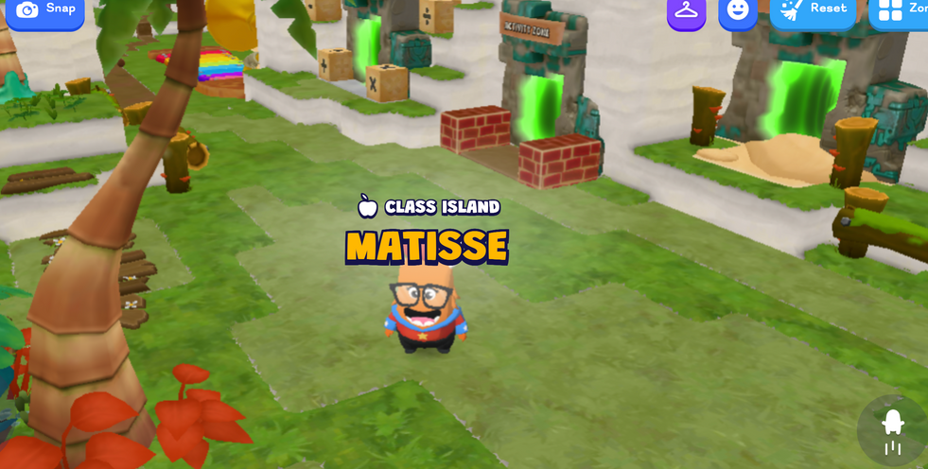
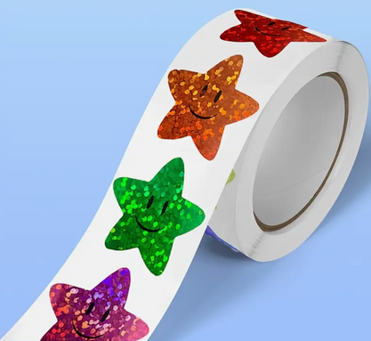
Behaviour Expectations
Ready Respectful Safe
Positive Note
Speedy Listening Tick
Teacher Star
Sticker in Book

Slide 12

Daily Timetable
Morning
08:40 – Early Morning Activity
(Spelling practise/GPS/Tables)
08:55 - Reading Comprehension
09:40 – Brain Break
09:45 - Literacy
10:30 - Assembly (Boaster/Intervention groups)
10:45 - Breaktime
11:00 - Maths
12:00 – Maths Mastery NCETM
12:15 - Lunchtime
Afternoon
13:15 OTTER Time –
silent reading
13:30 Foundation Subject
14:15 Daily Mile
14:20 Foundation Subject
15:00 Class Story
15:15 Home Time

Slide 13
Autumn Term Learning
Core Subjects
Maths
Literacy
Tar Beach by Faith Ringgold
Varmints by Helen Ward
FaRther by Grahame Baker-Smith
The Iron Man by Ted Hughes
Place Value
Addition and Subtraction
Area
Multiplication and Division A
Multiplication tables in Maths Mastery
Reading Comprehension
The Firework Maker's Daughter by Phillip Pullman
Award Winning Author
GPS
Science
Sentence structures
Using capital letters accurately
Common Exception Words
Spelling rules linked to Literacy Books
Science
Coast Guard and Firefighters to talk about safety and how we need to keep ourselves safe in the community.
Science: States of matter – investigation, exploration and discovery of how matter is all around us and how it can change states depending on difference variables.

Slide 14
Autumn Term Learning
Foundation Subjects
Geography
R.E.
Fieldwork Enquiry - Settlements
Types of settlements and their features.
OS maps and co-ordinates
Collecting qualitative data
Theology - Where do religious beliefs come from?
Computing
History
Romans - Expansion of the Roman Empire.
Boudicca’s revolt against the occupiers.
Innovations, inventions and imports from the Romans.
Trip to Colchester Castle
Computing Systems and Networks – The internet and how computers communicate.
Science
Design & Technology
Art & Design
Coast Guard and Firefighters to talk about safety and how we need to keep ourselves safe in the community.
Food - Roman Themed
Creating a new flavour of bread to be tasted at a Roman feast and sold across the empire. Only using ingredients available during the Roman era.
Autumn theme
Sketching real life objects inspired by the works of
Matisse and Cézanne, using a variety of media.

Slide 15
Autumn Term Learning
Foundation Subjects
P.E.
P.S.H.E
Tag Rugby
Basketball
Fitness
Tennis
VIP’s – Maintaining quality friendships, how kindness matters, building strategies to deal with disputes and how to recognise unacceptable behaviours that make them feel unsafe or uncomfortable, either online or in person. Informing children of the different ways they can report concerns to get support starting with conversations with trusted adults, class caring cubes to NSPCC and CEOP..
Music
10 x Ukelele lessons with Mrs Froud from
Essex Music Services Sept - Nov
Christmas Carol Service Practice- Dec

Slide 16
Teaching Year 3 & 4 – Lower Key Stage 2 (LKS2)
Maths – Following White Rose Education mixed year group planning with elements of the NCETM (National Centre for Excellence in the Teaching of Mathematics). Each lesson starts with the Year 3 learning objectives, which is good for Year 4 to revisit. Then progress to Year 4 objectives and questions adapted for independent tasks.
English – The National Curriculum already combines Year 3 and 4 together for Reading, Writing and Grammar, Punctations & Spelling (GPS). Children will have an expected success criteria for each lesson. We have created a 2-year plan to avoid any repetition of the literacy books we use.

Slide 17
Teaching Year 3 & 4 – Lower Key Stage 2 (LKS2)
Foundation Subjects – These are also on a 2-year rolling plan so children will experience different topics during their time LKS2.
P.E. - Skills will be developed by securing the Year 3 skills and building on these for the Year 4's.

Slide 18
Colchester Castle - 26.11.26
Completing various activities from building huts to learning about the battle between the Romans and Boudicca with the Celts in Colchester.
Viking Themed Day - Summer
Some fun projects
Teacher led activities from warrior training, making clay cups, weaving bracelets, feast.
VR Immersion Experience – 10.06.27
Children to be transported into different biomes through the magic of virtual reality. Exploring the wonders of the world from the Amazon Rainforest to the Namibian desert.
Visitors – Dates TBC
Essex Fire Service and Essex Police to talk about how to keep safe at home and in the community.

Slide 19
Communication
We believe that open communication is key to a successful school year. Here are the best ways we shall do this :
Google Classroom: Class Information, Spelling
School Website: www.priory.essex.sch.uk
School Newsletter
To speak to me directly:
Chat after school - this is easier than in the mornings.
E-mail the school office: admin@priory.essex.sch.uk
Pop into the school office with a message
and I will get back to you.

Slide 20
Q&A
Is there anything else you would like to know?

Slide 21
Thank you!
Thank you for taking the time to listen or read the information!
We are excited for the year ahead and look forward to all the growth, achievements and memories we will share together.

