Slide 1
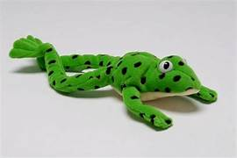

Phonics Reading Meeting
22nd September 2026

Slide 2
What is Read Write Inc. Phonics?
https://schools.ruthmiskin.com/training/view/NCEerA0x/zOiuQFRj

Slide 3
How to say the sounds
https://schools.ruthmiskin.com/training/view/uTcuRxJy/ZywNl8xb

Slide 4
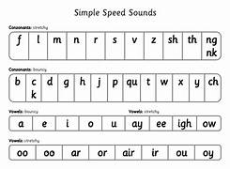
Let’s have a go…!
s-p-or-t

Slide 5
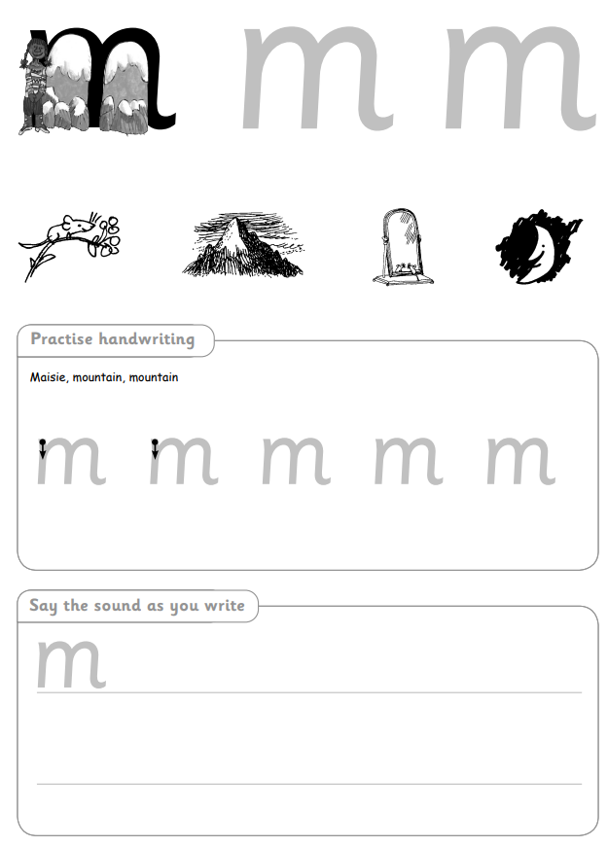

What will your child bring home?
Sound videos- Your child will have a QR code stuck into their reading diary after learning each new sound.
https://schools.ruthmiskin.com/training/view/gxlZ0J0O/bHimSFyX
Letter formation sheets to practise the sounds learnt.
A wordless book to develop communication skills
A storybook to share. (Chosen from the school library/ book corner)

Slide 6
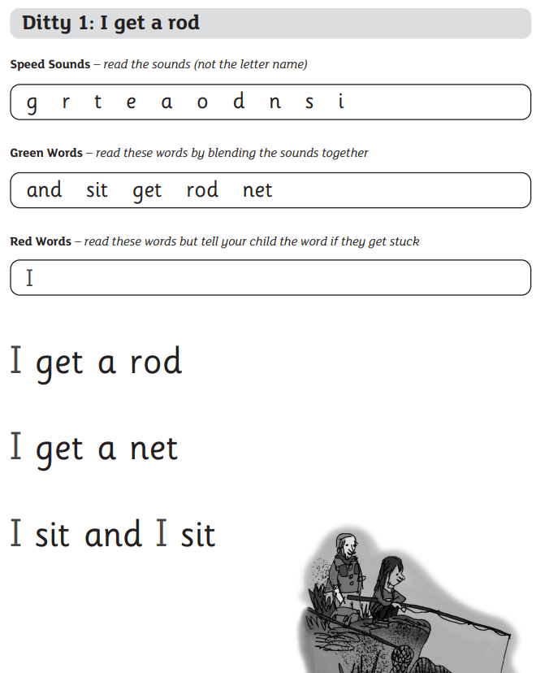
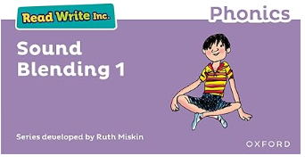

What texts/books will your child read?

Slide 7
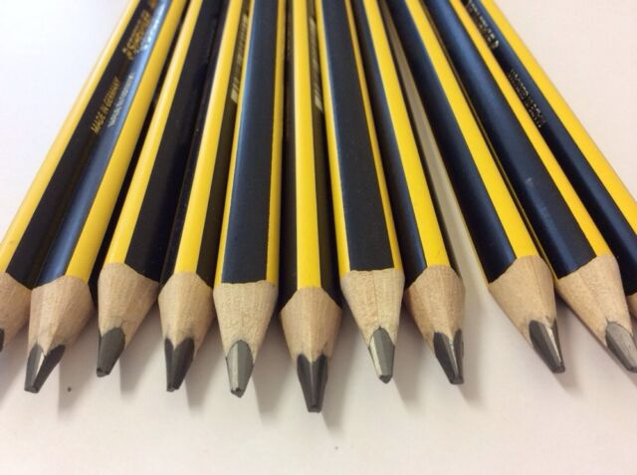
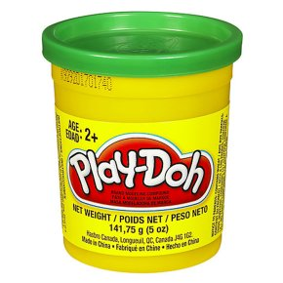

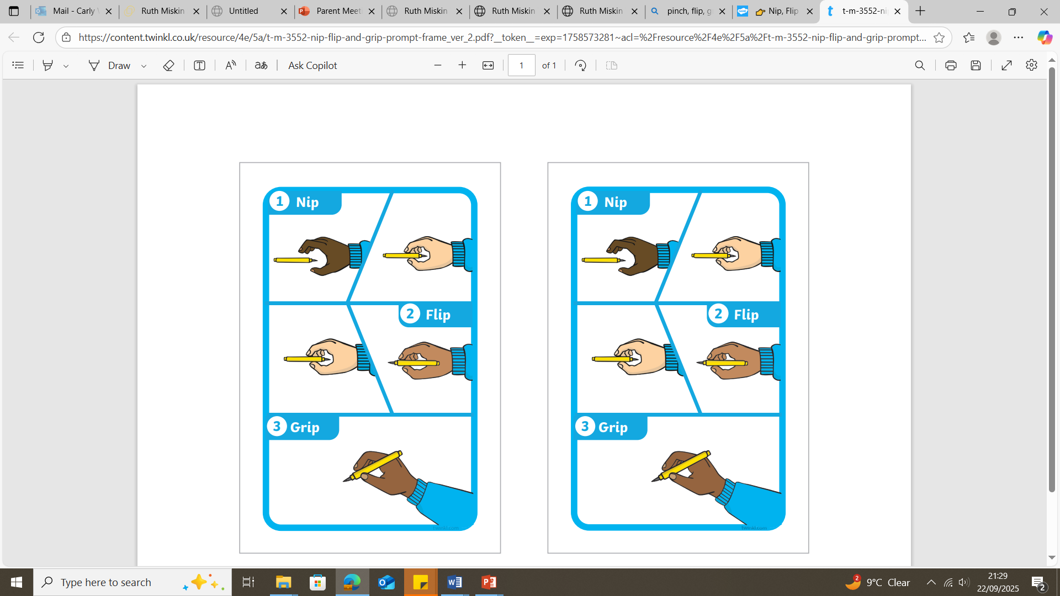
How to hold a pencil- Tripod Grip
‘Nip, Flip and Grip’

Slide 8
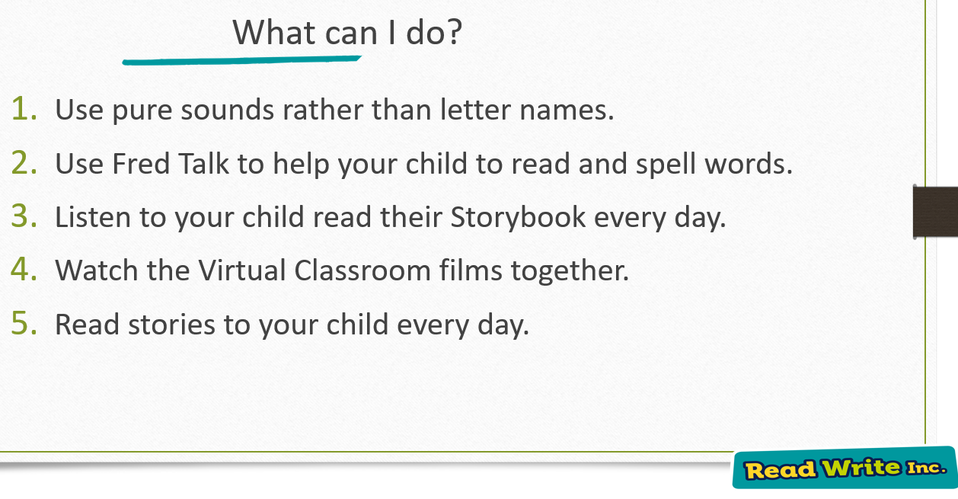

Slide 9

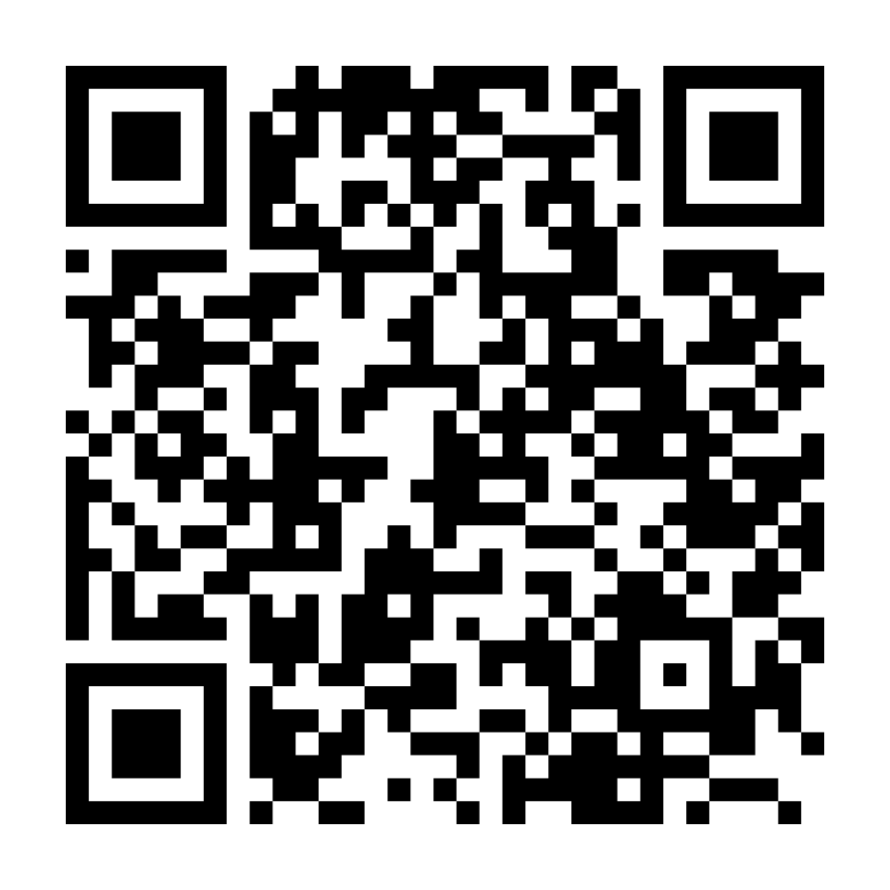
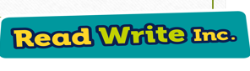
Parents, Carers and Families Webpage

Slide 10

Do you have any questions?

